Slide 1
Arm CMSIS and Software Drivers

Slide 2
Module Syllabus
The Cortex Microcontroller Software Interface Standard (CMSIS)
Design and Implementation of Standard Low-level Software Drivers for Peripherals

Slide 3
Building a System on a Chip (SoC)
Software high-level
application development
Application Design (e.g., Game)
Application Programming Interface (API)
Software low-level drivers & libraries programming
Arm CMSIS-Core
Peripheral Drivers
Arm Cortex-M0
Processor
Timer
Peripheral
GPIO
Peripheral
7-Segment
Peripheral
Hardware design
AHB
Memory
VGA
Peripheral
UART
Peripheral
Interrupt
Notes:
This module explores how to use CMSIS functions to ease the programming of Cortex-M0 microprocessor and how to design and implement standard low-level software drivers for peripherals.

Slide 4
What Is CMSIS?
CMSIS: Cortex Microcontroller Software Interface Standard
CMSIS is a vendor-independent hardware abstraction layer for the Cortex-M processor series.
CMSIS provides a standardized software interface, such as library functions that can help us control the processor easily; e.g., configuring the nested vectored interrupt controller (NVIC).
Main function is to improve the software portability between different Cortex-M serial processors and microcontrollers
Configure Cortex-M0 by directly accessing its
registers in its internal memory space,
e.g., *(unsigned int*) NVIC_INT_ENABLE = 0x01;
Configure Cortex-M serial processors
by using CMSIS libraries,
e.g., NVIC_EnableIRQ(Timer_IRQn);
Arm CMSIS-Core
Arm Cortex-M0
Processor
Cortex-M0
Cortex-M
Cortex-M3
Cortex-M4
Notes:
It is becoming increasingly important for software developers to be able to reuse software code. This is due to the continued rise of the complexity of embedded systems. This helps reducing development time for subsequent projects and for market releases. In addition, software compatibility assists the integration of third-party software components; such practice is becoming increasingly common. Compatibility is becoming critical for many large-scale software projects; this is due to (again) the continued rise of the complexity of embedded systems and the need to reduce development time. CMSIS is a software interface standard, specifically developed by Arm and its partners, to enhance software portability. It supports the majority of the Cortex-M processor series. CMSIS provides a standardized software interface to the processor features, such as library functions that can help us control the processor easily; e.g., configuring the nested vectored interrupt controller (NVIC). Many of these processor’s feature access functions are available in CMSIS for the Cortex-M0, Cortex-M3, and Cortex-M4, allowing easy software porting between these processors.

Slide 5

What Is Standardized in CMSIS?
Standardized functions to access NVIC, system control block (SCB), and system tick timer (SysTick); for example:
Enables an interrupt or exception: NVIC_EnableIRQ (IRQn_Type IRQn)
Sets pending status of interrupt: void NVIC_SetPendingIRQ (IRQn_Type IRQn)
Standardized access of special registers; for example:
Read PRIMASK register: uint32_t __get_PRIMASK (void)
Set CONTROL register: void __set_CONTROL (uint32_t value)
Standardized functions to access special instructions; for example:
REV: uint32_t __REV(uint32_t int value)
NOP: void __NOP(void)
Standardized name of system initialization functions; for example:
System initialization: void SystemInit(void)
Notes:
There are a number of embedded software areas that have been standardized in CMSIS. These are listed above. In addition, CMSIS provides a common platform for device driver libraries. Each device driver library has structure software porting.

Slide 6
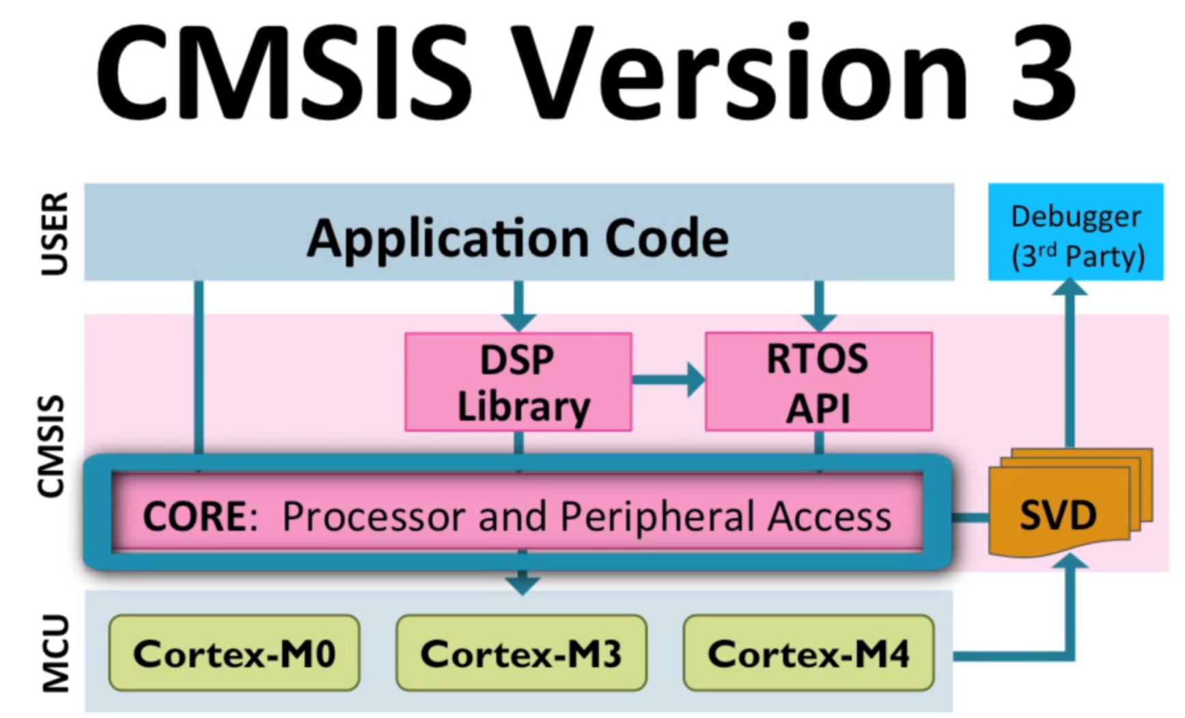
CMSIS Components
The CMSIS consists of the following components:
CMSIS-CORE
CMSIS-DSP, CMSIS-RTOS API, and CMSIS-SVD
This course focuses on CMSIS-CORE.
Notes:
CMSIS-CORE provides an interface to Cortex-M0, Cortex-M3, Cortex-M4, SC000, and SC300 processors and peripheral registers. CMSIS-DSP includes over 60 functions in fixed-point (fractional q7, q15, q31) and single precision floating-point (32-bit) implementation. CMSIS-RTOS API is a standardized programming interface for real-time OSs for thread control, resource, and time management. CMSIS-SVD (System View Description) is an XML files that contain the programmer's view of a complete microcontroller system, including peripherals.

Slide 7
Access NVIC Using CMSIS
CMSIS function | Description
void NVIC_EnableIRQ (IRQn_Type IRQn) | Enables an interrupt or exception
void NVIC_DisableIRQ (IRQn_Type IRQn) | Disables an interrupt or exception
void NVIC_SetPendingIRQ (IRQn_Type IRQn) | Sets the pending status of interrupt or exception to 1
void NVIC_ClearPendingIRQ (IRQn_Type IRQn) | Clears the pending status of interrupt or exception to 0
uint32_t NVIC_GetPendingIRQ (IRQn_Type IRQn) | Reads the pending status of interrupt or exception. This function returns a non-zero value if the pending status is set to 1.
void NVIC_SetPriority (IRQn_Type IRQn, uint32_t priority) | Sets the priority of an interrupt or exception with configurable priority level to 1
uint32_t NVIC_GetPriority (IRQn_Type IRQn) | Reads the priority of an interrupt or exception with configurable priority level. This function returns the current priority level.
Notes:
There are a number of standardized functions included in the CMSIS; these mainly include access functions for peripherals, registers, and special instructions.

Slide 8
Access Special Registers Using CMSIS
Special register | Access | CMSIS function
PRIMASK | Read | uint32_t __get_PRIMASK (void)
 | Write | void __set_PRIMASK (uint32_t value)
CONTROL | Read | uint32_t __get_CONTROL (void)
 | Write | void __set_CONTROL (uint32_t value)
MSP | Read | uint32_t __get_MSP (void)
 | Write | void __set_MSP (uint32_t TopOfMainStack)
PSP | Read | uint32_t __get_PSP (void)
 | Write | void __set_PSP (uint32_t TopOfProcStack)
Notes:
The CMSIS includes functions for reading from or writing to core registers. In this table, we can see a few examples of how we can access and modify these registers. For example, to read from the PRIMASK register, we can use uint32_t __get_PRIMASK (void).

Slide 9
Execute Special Instructions Using CMSIS
Instruction | CMSIS intrinsic function
CPSIE i | void __enable_irq(void)
CPSID i | void __disable_irq(void)
ISB | void __ISB(void)
DSB | void __DSB(void)
DMB | void __DMB(void)
NOP | void __NOP(void)
REV | uint32_t __REV(uint32_t int value)
REV16 | uint32_t __REV16(uint32_t int value)
REVSH | uint32_t __REVSH(uint32_t int value)
SEV | void __SEV(void)
WFE | void __WFE(void)
WFI | void __WFI(void)
Notes:
We can also use CMSIS to execute special instructions. The table here lists some of the Cortex-M0 special instructions and their corresponding CMSIS intrinsic functions. For example, in order to enable interrupt, we can use void __enable_irq(void); this will clear PRIMASK. Another example is controlling the processor sleeping modes; we can use void __WFE(void) or void __WFI(void).

Slide 10
Access System Using CMSIS
CMSIS function | Description
void NVIC_SystemReset(void) | Initiate a system reset request.
uint32_t SysTick_Config(uint32_t ticks) | Initialize and start the SysTick counter and its interrupt.
void SystemInit (void) | Initialize the system.
void SystemCoreClockUpdate(void) | Update the SystemCoreClock variable.
Notes:
We can also use CMSIS for system control and SysTick setup. For example, to initiate a system reset request, we can use the CMSIS function void NVIC_SystemReset(void), which does not need any parameters. To initialize the system, we can use the CMSIS function void SystemInit (void), which does not need any parameters. To update the SystemCoreClock variable, we can use void SystemCoreClockUpdate(void); the latter is device-specific and should be used every time the clock settings are changed. The uint32_t SysTick_Config(uint32_t ticks) CMSIS programs the SysTick to generate a SysTick exception for every “ticks” number of core clock cycles. The parameter ticks is the number of clock ticks between two interrupts.

Slide 11

Benefits of CMSIS
Easier to port application code from one Cortex-M microcontroller to another Cortex-M microcontroller
Less effort to reuse the same code between different Cortex-M-based microcontrollers
Better compatibility when integrating third-party software components; applications, embedded OS, middleware, etc., can share the standard CMSIS interface
Better code density and smaller memory footprint, since the codes in CMSIS have been tested and optimized

Slide 12





Device Driver
What is a device driver?
The software program used to control a particular hardware peripheral
What is the purpose of drivers?
Providing a simplified, easy-to-use interface for application developers
Video driver
Mouse driver
Audio driver
Memory driver
Source: https://en.wikipedia.org/wiki/Device_driver
Notes:
A device driver is a software program that controls a specific hardware peripheral. It provides an additional layer of abstraction that allows OSs and other programs to communicate with specific hardware block functions without the need to know the exact details of the hardware being accessed. The software typically calls a routine in the driver, which triggers the latter to instruct its corresponding hardware to perform tasks (reads data, sends data back, etc.). The hardware peripheral can also sometimes evoke routines in the main program by sending data back or generating interruption signals.
It should be noted that drivers are hardware-dependent and operating-system-specific; so, the driver for a 16550 UART is different from the driver for a FTDI serial port converter, even if both drivers perform the same generic functions such as “send data” or “receive data”.

Slide 13
Device Driver
In OS development, drivers are normally low level components that directly interface with physical devices.
The development of drivers commonly involves both the physical device vendors (physical level) and the OS vendors (logical level).
Most drivers can provide generic functions that allow developers to write higher-level applications independently from specific hardware.
High-level
Programming
User Application
OS Shell
OS Kernel
Video Driver
Audio Driver
Memory Driver
Mouse Driver
Low-level
Programming
Notes:
The task of writing a driver for a hardware device requires very good understanding of how the hardware and software works/interacts. Most drivers can provide generic functions that allow developers to write higher-level application independently from specific hardware. Therefore, it is usually the case that device drivers are written by software engineers working for hardware-design companies. This is because they usually have a much better understanding than most outsiders of how their hardware works. In addition, it is usually considered in the hardware manufacturer's interest to guarantee that their customers can use their hardware in an ideal manner. The development of drivers commonly involves both the physical device vendors (physical level) and the OS vendors (logical level). In this module, we will focus on writing device drivers for the peripherals connected to the AHB bus in our SoC.

Slide 14
AHB Peripheral Drivers
In this course:
We will write the software driver for each peripheral (except memory controller).
No OS is required.
Software drivers should provide basic functions to ease the access to peripherals.
Functions to access peripherals
VGA
Software Driver
UART
Software Driver
Timer
Software Driver
GPIO
Software Driver
7-Segment
Software Driver
VGA
Peripheral
UART
Peripheral
Timer
Peripheral
GPIO
Peripheral
7-Segment
Peripheral

Slide 15
Using Pointer to Access Peripherals
Peripherals and their registers are mapped to the global memory space; hence, they can be accessed using memory pointers.
#define AHB_TIMER_BASE 0x52000000
#define AHB_TIMER_INITVALUE (*((volatile unsigned long *)(AHB_TIMER_BASE + 0x00)))
#define AHB_TIMER_CURVALUE (*((volatile unsigned long *)(AHB_TIMER_BASE + 0x04)))
#define AHB_TIMER_CONTROL (*((volatile unsigned long *)(AHB_TIMER_BASE + 0x08)))
#define AHB_TIMER_CLEAR (*((volatile unsigned long *)(AHB_TIMER_BASE + 0x0C)))
// timer initialization function
void timer_init (int value, int control) {
AHB_TIMER_INITVALUE = value;
AHB_TIMER_CONTROL = control;
AHB_TIMER_CLEAR = 0;
}
Notes:
As we saw in the previous module, in the Cortex-M0, it is very easy to define the base address of a peripheral using C language, as illustrated in this example, where we use the directive #define to define the address of the AHB timer. This way, peripherals and their registers can be mapped to the global memory space and can be accessed using memory pointers. Once the address of a peripheral is defined, it can be written to and read using C language. This solution is fine for simple applications. However, if multiple instances of the same type of peripheral are available at the same time, we need to define the registers for each peripheral, which makes the maintenance of the code difficult. Furthermore, since each register is defined as a separate pointer, each register access requires a 32-bit address constant. As a result, the program image will consume more memory space.

Slide 16
Define Data Structure for Peripherals
To further simplify the code and reduce code length, we can:
Define the peripheral register set as a data structure.
Define the peripheral as a memory pointer to this data structure.
typedef struct {
volatile unsigned int INITVALUE;
volatile unsigned int CURVALUE;
volatile unsigned int CONTROL;
volatile unsigned int CLEAR;
} TIMER_TypeDef;
#define AHB_TIMER_BASE 0x52000000
#define TIMER ((TIMER_TypeDef *) AHB_TIMER_BASE )
void timer_init (int value, int control) {
TIMER->INITVALUE = value;
TIMER->CONTROL = control;
TIMER-> CLEAR = 0;
}
Notes:
To further simplify the code of the driver software and reduce code length, we can define the peripheral register set as a data structure, and then define the peripheral as a memory pointer to this data structure, as shown in this example. Such configuration makes it possible to share the peripheral data structure among several instances, which facilitates the maintenance of the code. It should be noted here that in most cases, all registers are defined as 32-bit words, since most peripherals are connected to the 32-bit AHB bus.

Slide 17
Functions Reuse Between Multiple Units
For example, the same function can be reused by passing different base pointers:
typedef struct {
volatile unsigned int INITVALUE;
volatile unsigned int CURVALUE;
volatile unsigned int CONTROL;
volatile unsigned int CLEAR;
} TIMER_TypeDef;
#define AHB_TIMER0_BASE 0x52000000
#define AHB_TIMER1_BASE 0x52100000
#define TIMER0 ((TIMER_TypeDef *) AHB_TIMER0_BASE )
#define TIMER1 ((TIMER_TypeDef *) AHB_TIMER1_BASE )
void timer_init (TIMER_TypeDef *timer_pointer) {
timer_pointer >INITVALUE = value;
timer_pointer >CONTROL = control;
timer_pointer > CLEAR = 0;
}

Slide 18
Define AHB Peripherals
Now we can define all the AHB peripherals in the device header file (e.g., edk_cm0.h) using the same standard format:
#define AHB_VGA_BASE 0x51000000
#define AHB_UART_BASE 0x52000000
#define AHB_TIMER_BASE 0x52000000
#define AHB_GPIO_BASE 0x53000000
#define AHB_7SEG_BASE 0x54000000
typedef struct{
…
} VGA_TypeDef;
typedef struct{
…
} UART_TypeDef;
…
#define VGA ((VGA_TypeDef *) AHB_VGA_BASE )
#define UART ((UART_TypeDef *) AHB_UART_BASE )
#define TIMER ((TIMER_TypeDef *) AHB_TIMER_BASE )
#define GPIO ((GPIO_TypeDef *) AHB_GPIO_BASE )
#define SEVSEG ((SEVENSEG_TypeDef *) AHB_7SEG_BASE )
Notes:
Once the drivers software are written for all AHB peripherals, we need to define these peripherals in the device header file using the same standard format. The device header file <device.h> contains the following four sections that are device specific:
Interrupt number definition that provides interrupt numbers (IRQn) for all exceptions and interrupts of the device
Configuration of the processor and core peripherals that reflect the features of the device
Device peripheral access layer that provides definitions for the peripheral access to all device peripherals. It contains all data structures and the address mapping for device-specific peripherals.
Access functions for peripherals (optional) provide additional helper functions for peripherals, which are useful for the programming of these peripherals.
Access functions may be provided as inline functions or can be external references to a device-specific library provided by the silicon vendor. The definition of the AHB peripherals given in this example will need to go in Section 3 of the device header files.

Slide 19
Examples of Simple Functions
Peripheral | Function | Description
VGA | void VGA_plot_pixel (int x, int y, int col); | Plot a pixel in the image region.
7-segment display | void seven_seg_write(char dig1, char dig2,char dig3,char dig4); | Write four digits on the 7-segment display.
Timer | void timer_init (int load_value, int prescale, int mode); | Initialize the timer.
 | void timer_enable(void); | Enable the timer.
 | void timer_irq_clear(void); | Clear interrupt request from the timer.
GPIO | int GPIO_read(void) | Return with the value read from the input port.
 | void GPIO_write(int data) | Write a value to the GPIO output.
Notes:
This table summarizes some simple example functions you can write for each peripheral.

